Slide 1



An Introduction to the R Programming Language for Biologists
ADF&G Workshop
April 16–18, 2025
Logan Wendling & Matt Tyers

Slide 2
…coming to a Teams window near you!
We will be using Teams to chat, share files, take polls, etc.
HELP US KEEP THIS INTERACTIVE
Turn on your camera if you feel comfortable doing so!
Speak up or raise your hand if you want clarification
Please resist the temptation to multitask

Slide 3
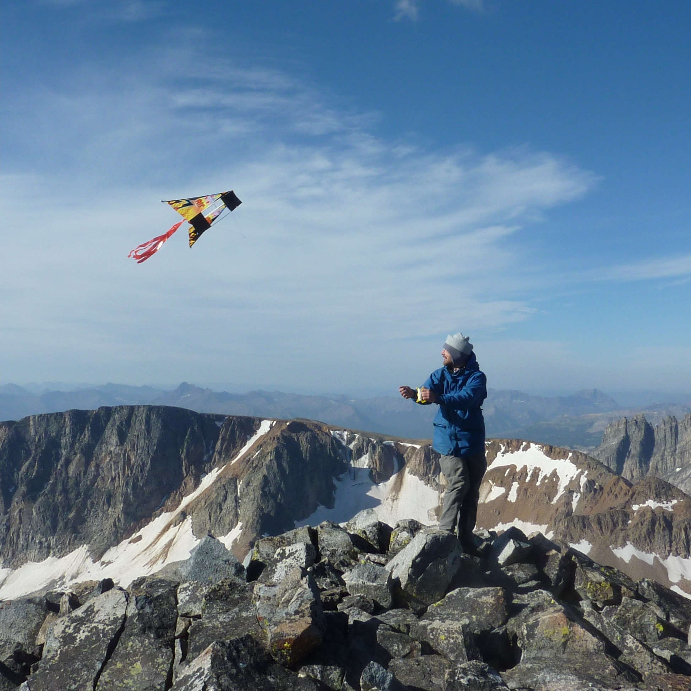

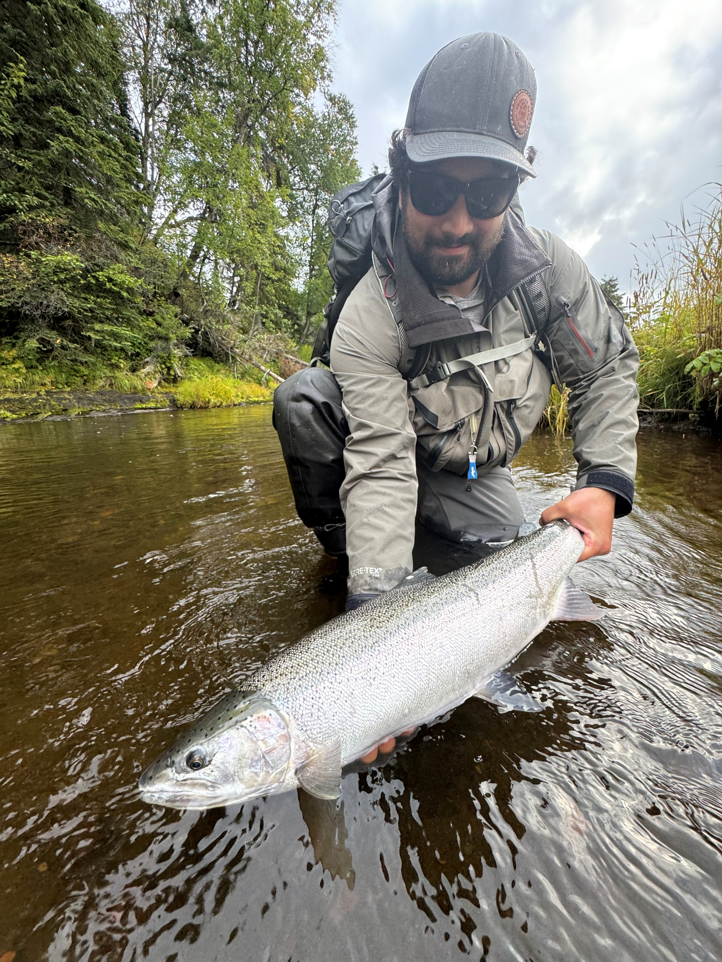
Logan Wendling
Learned R tools throughout school (easy way) &
taught myself (hard but fun way)
ADF&G Sport Fish Biometrician in Anchorage
Matt Tyers
Old-skool syntaxer
But I’m learning
ADF&G Sport Fish Biometrician in Anchorage

Slide 4
Proctor Introductions!
Anchorage – Jiaqi Huang
Douglas – Maya Chari
Kenai – Kyle Gatt
Anchorage – Mike Martz

Slide 5
Introductions!
In the chat, write a sentence or two about yourself:
Where your home ADF&G office is
Something specific you’d like to take away from this course
Notes:
Have everyone introduce themselves in 1-2 sentences

Slide 6


Welcome
What you’ll need today:
Computer with R & RStudio installed
Files that we emailed over
If there is something that is wrong (e.g., broken link) or could be explained better, please message us immediately and/or write it down.
After the course, there will be a survey to give us feedback on improvements

Slide 7

Our Roadmap
Most sections will have:
Some form of presentation
Some “demonstrative coding” along with us
A chance to code on your own!
Today:
All your
Base-R
belong to us
1 – Welcome!
2 – Introducing R & RStudio
3 – Programming basics, part 1
4 – Programming basics, part 2
5 – Introduction to the Tidyverse
6 – ggplot
7 – Data manipulation
8 – Intermediate/advanced/really cool topics
9 – Project!
10 – Wrapup & what’s next?
Tomorrow:
Enter the
Tidyverse
Friday:
The
fun stuff
The Project:
Be thinking about some data you’d like to play with
…and what you’d like to try
…and what problems it might have
(We have some data if you don’t)

Slide 8
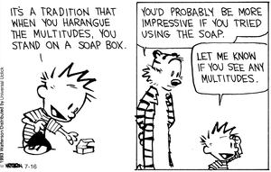
So why are we here?
Why should we learn any of this when we can just do things in Excel???
Reproducibility
“You can’t reproduce a point-and-click trail” – a wise professor Matt once had
Transparency
Scripting will create a record of every data manipulation step (in order)
…plus makes it easy to leave notes associated with each step
Robustness to human error
With a record of all steps, it’s more likely that a data error will be spotted
…AND YOU CAN FIX IT without redoing the whole thing!!!
Efficiency
Once you write a routine, you can easily repeat it
Notes:
it’s worth taking a moment to motivate what we’re doing. Chances are, you’re a very proficient Excel user, and you’re good at your job. And here we are pushing this new thing, so it’s worth talking about WHY.
So without going into the statistical and graphical tools that R provides, I’d just like to talk about reproducibility…

Slide 9
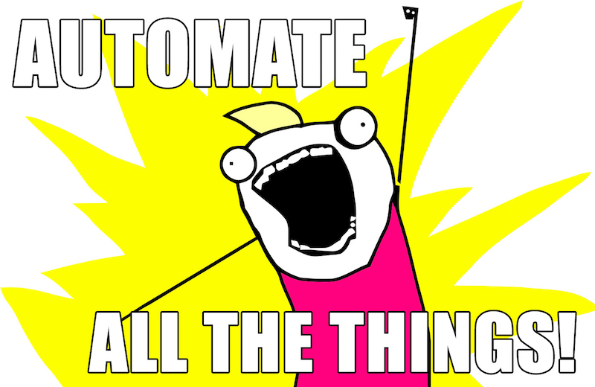
Notes:
“anything that CAN be automated, SHOULD be automated”

Slide 10
Ok, so why R?
It’s free!
It’s (relatively) simple to learn
“high-level” language: you don’t have to be a computer scientist to write code
It’s powerful
Many sophisticated tools are already included
Easy to install packages that do even more!
It’s everywhere
R is becoming standard for research & academia
It’s growing
The worldwide R community is friendly, helpful, and diverse
Continued development & extension of new tools!
Notes:
So why R? Why not SAS, or Matlab, or C++, or any other script-based tool?

Slide 11
Expectations for this course…
We’re learning a new language!
New vocabulary
New grammar rules
Only really possible with immersion
It won’t fully make sense until you use it
Notes:
So to set the stage for the next couple days, it’s really useful to approach this like learning a new LANGUAGE. Which … it is.
In that: it’s necessary to learn new vocab AND new grammar rules at the same time, otherwise it doesn’t make sense. So be patient with yourselves, because it’s a stretch!
Also, it’s really only possible with immersion, and it won’t REALLY make sense until you USE it. And ideally, when you use it on your OWN stuff!

Slide 12
Expectations for this course…
This will be an intensive but rewarding course
As such, it requires your complete attention
Close out of your email. Please be fully present

Slide 13
Course Outcomes
By the end of this class, you will be familiar with the basics of R
Hopefully, you’ll be familiar enough to read it, and use these slides for future reference
Don’t get bogged down in the details or try to memorize everything, this is a language after all.
We will go through code together, then you can run through it on your own later
Ask questions in the chat or raise hand
Answer each others' questions or “like” questions that are tricky
The More You Know
Notes:
Because of this, the slides are intentionally a little bit wordy. I apologize for that as it makes the aesthetics worse but I want this document to serve a little bit as a reference guide for you.
Today might be slow but we’re laying the foundation for charts & modeling
Not everyone needs to be an expert, but if you’re here, I want you to move up a level and at least be able to “read” R

Slide 14
Learning Philosophy
This is a “failure positive” zone!
You can’t break anything. Be creative, think like a kid, see what happens when you type things.
Ask questions! No dumb questions when you’re learning a language
Every error is an opportunity: Ask why something didn’t work
Communicate when we’re going too fast
Notes:
Teaching philosophy thanks to:
http://teachtogether.tech/en/index.html
https://journals.plos.org/ploscompbiol/article?id=10.1371/journal.pcbi.1006023

Slide 15
Learning Philosophy
This is a “failure positive” zone!
You can’t break anything. Be creative, think like a kid, see what happens when you type things.
Ask questions! No dumb questions when you’re learning a language
Every error is an opportunity: Ask why something didn’t work
Communicate when we’re going too fast
It’s OK to fail!
Ask us questions!
Ask why it didn’t work!
Help us help you!
Notes:
These points are so important that I’m going to reiterate them again here.
This point, especially the last one, can be the difference between success and frustration.

